Slide 1


Slide 2

Emotions push us to action.

Slide 3
Engagement, sharing, purchasing

Slide 4
“With content marketing, the message is the virus, the carriers are your audience and a strong emotional connection to the message is the catalyst.” - Martin Jones, Head of Social Media and Content Marketing, Cox

Slide 5
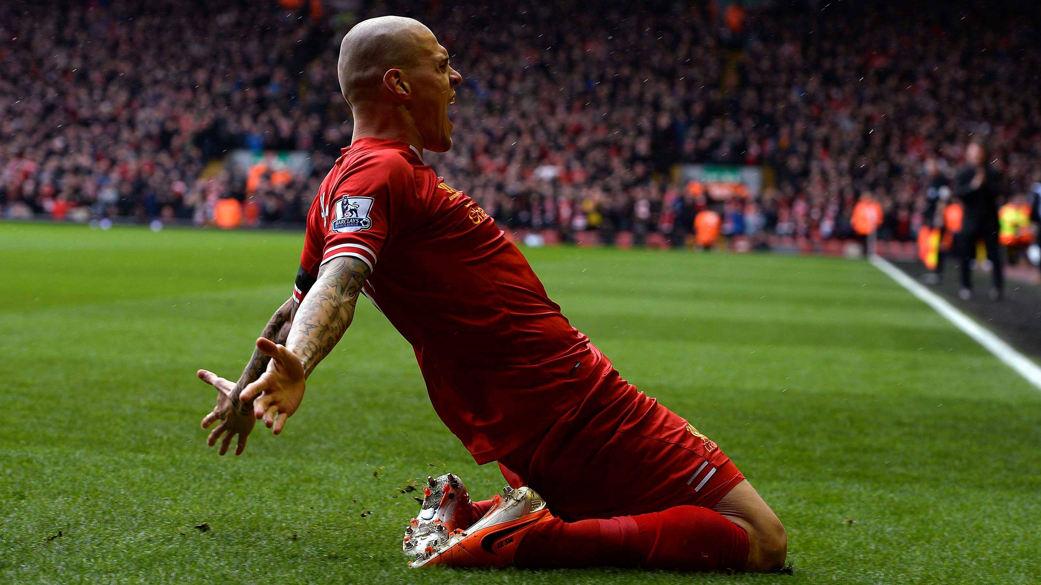

Brands have tried to elicit emotions for years

Slide 6
We interviewed 4 CMOs who expressed the emotions that signify their brand.

Slide 7
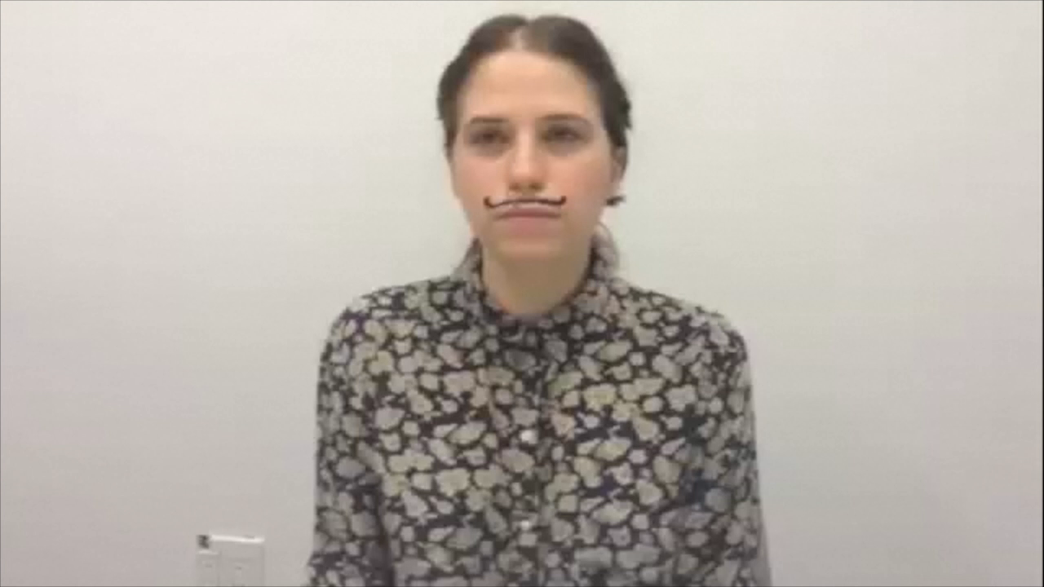

Slide 8
If brands are going to craft emotional connections, they need to do it right.

Slide 9
What if you could intelligently predict which content will elicit the emotion you desire?

Slide 10

Passion
Notes:
In under 5 seconds…
What if Nike could surface content that made their audience feel

Slide 11

Comfort
Notes:
In under 5 seconds…
What if Nike could surface content that made their audience feel

Slide 12

Trust
Trust
Notes:
In under 5 seconds…
What if Visa could surface content that made their audience feel

Slide 13
Integrity
Notes:
In under 5 seconds…
What if BP could surface content that made their audience feel a sense of

Slide 14
Introducing…

Slide 15
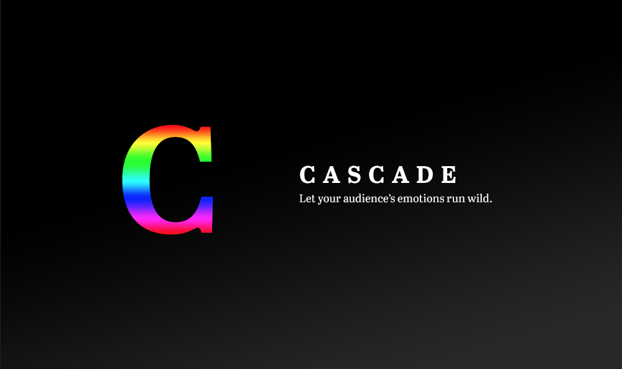
Team Awesome (AKA Finger Snap Clap)

Slide 16
For example

Slide 17
Brands we love

Slide 18

Nike
Transforming Nike’s brand purpose into a daily content strategy.
Maybe
Even
Include
Some
Bullet
Points

Slide 19
Brands we hate

Slide 20
Video of John Mulaney Delta Airlines talk

Slide 21
Delta
Re-build Delta’s brand affinity through emotional content.
Maybe
Even
Include
Some
Bullet
Points

Slide 22
So, why does NewsCred need this?

Slide 23

Content recommendations that go beyond a topic
Notes:
We have created a definitive place in the market based on our robust content offer and the data attached to each piece of content. This takes it a step further, helping marketers tie each story to their business objectives

Slide 24
Reach
Triggering the correct emotions facilitates virality. -- EffectiveBrands, Marketing 2020 Study
Engagement
When people develop strong, deep feelings like surprise, anger, fear, disgust, sadness and joy around an experience or message, social sharing becomes impulsive.” -- Business2Community
Conversions
“Purchases actually go up when there’s emotion behind them, and they’re more likely to be repeated too.” --Gensler’s 2013 Brand Engagement Survey :The Emotional Power Of Brands
Notes:
The main 3 goals of content marketing can be better achieved through evoking emotions

Slide 25
Cascade means:
A marketers can rest assured that each piece of content will elicit the emotion they want
A marketer can maintain their brand identity and purpose consistently
A marketer can build a brand personality
Notes:
We have created a definitive place in the market based on our robust content offer and the data attached to each piece of content. This takes it a step further, helping marketers tie each story to their business objectives

Slide 26
Our company is moving towards people-focused marketing. At the core of connecting with people is emotion.
Notes:
We have created a definitive place in the market based on our robust content offer and the data attached to each piece of content. This takes it a step further, helping marketers tie each story to their business objectives

